Slide 1
Creating the context for a new generation of
highly targeted, highly informative
clinical trials
Notes:
What are our research needs over the next 5-10 years?
What is the first responsibility of the dementia research community?
“To work together” The politics of affection

Slide 2

The collaborative challenge
Benefits sharing
Exchange of value between stakeholders
Data as a ‘public good’
Shared without restriction or cost
Reducing transaction costs
Making life easier!

Slide 3
The experimental medicine challenge
Cognitive
Health
Preclinical
Prodromal
Identify early
determinants
Identify early treatments to delay onset
Dementia
Identify treatments
To relieve symptoms and
slow progression
Age
45
60
75
90

Slide 4
The
The precision medicine challenge
The precision medicine challenge
5000 people
50,000 people
500,000 people
256
256
256
Age at risk:
Age at risk:
80-89
80-89
128
128
128
70-79
70-79
64
Age at risk:
64
64
60-69
80-89
32
32
60-69
32
50-59
70-79
50-59
16
60-69
16
16
40-49
8
50-59
8
40-49
8
4
40-49
4
4
2
2
2
1
1
1
120
140
160
180
120
140
160
180
120
140
160
180
Usual SBP (mmHg)
Usual SBP (mmHg)
Usual SBP (mmHg)
Notes:
Data taken from the Prospective Studies Collaborative meta-analysis co-ordinated by CTSU, Oxford and illustrates graphically the need for very large sample sizes to reliably study interactions (in this example the interaction between BP and age).
The first graph (All) shows the relationship between systolic BP and age on Ischemic Heart Disease (IHD – floating absolute risk) in 1-million people published in the Lancet in 2002 and the other two graphs show the same relationship in randomly selected samples of 500,000 and 50,000. The tight 95% Confidence Intervals illustrate the reliability of the large sample size in the first two graphs, but the sample in only 50,000 (which is still orders of magnitude larger than many studies) has very wide confidence intervals, particularly in younger people.
Key Message: studies at least as large as UK Biobank are required to study gene-environment interactions and for many interactions reliable evidence will only be generated by combining data from 4-5 biobanks worldwide – this emphasises the need for harmonisation of biobanks at an international level.

Slide 5
Core enabling utilities
Identification of highly characterised participants
Recruitment of stratified samples
Discovery studies, trials, in-silico experiments
Technology capacity building:
Imaging, stem cells, bioinformatics:
Sharing best practice, niche expertise
Standardising protocols, streamlining governance
Rapid data access:
Triangulation between multiple independent datasets
>30 cohorts: 2M participants

Slide 6
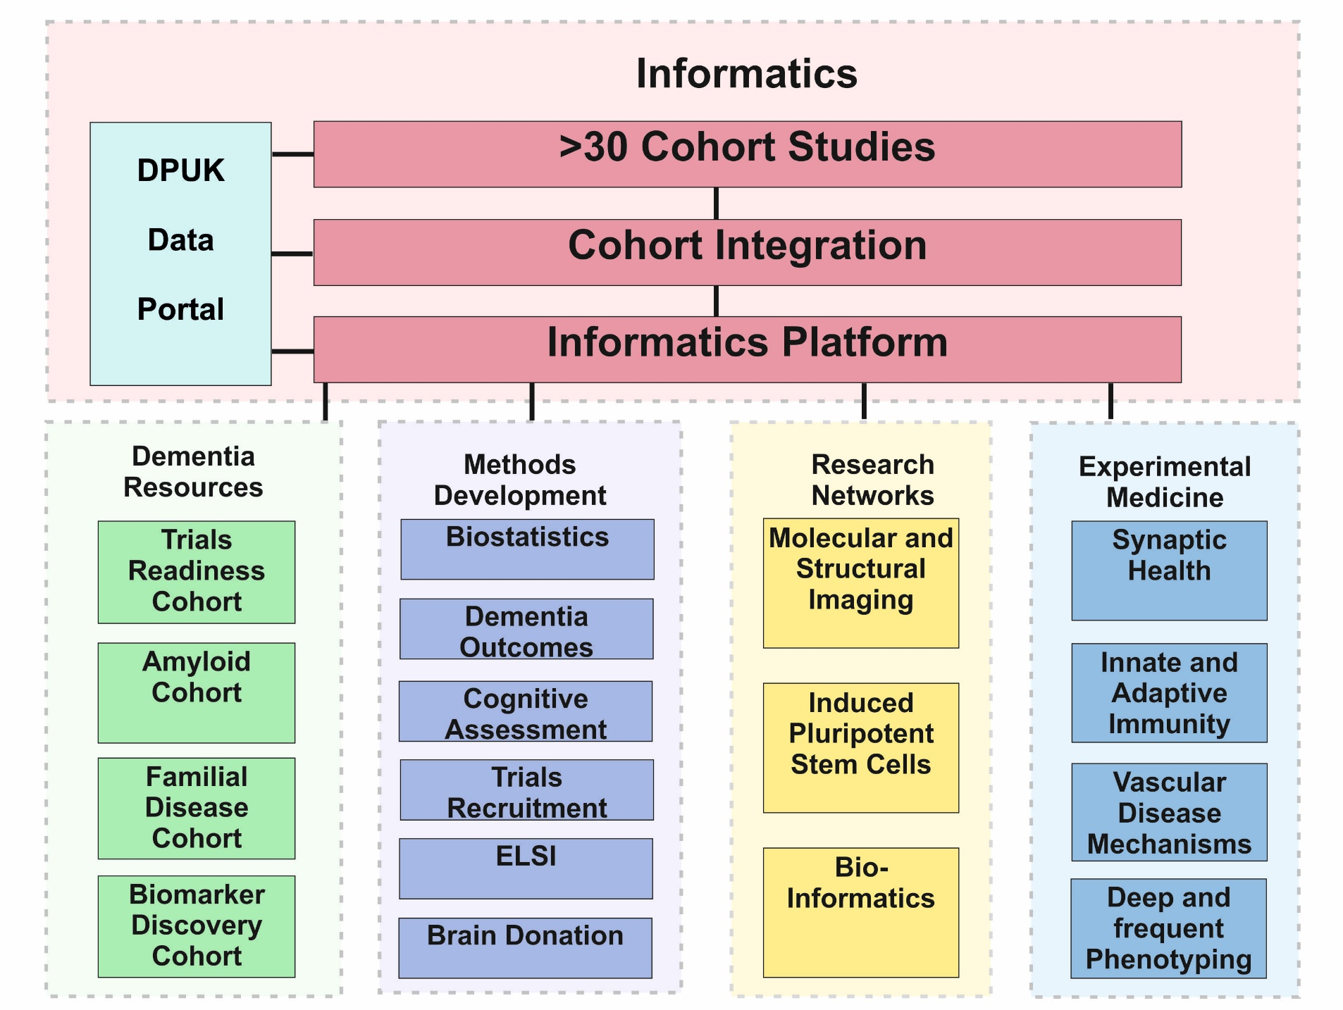
Integrated Infrastructure

Slide 7
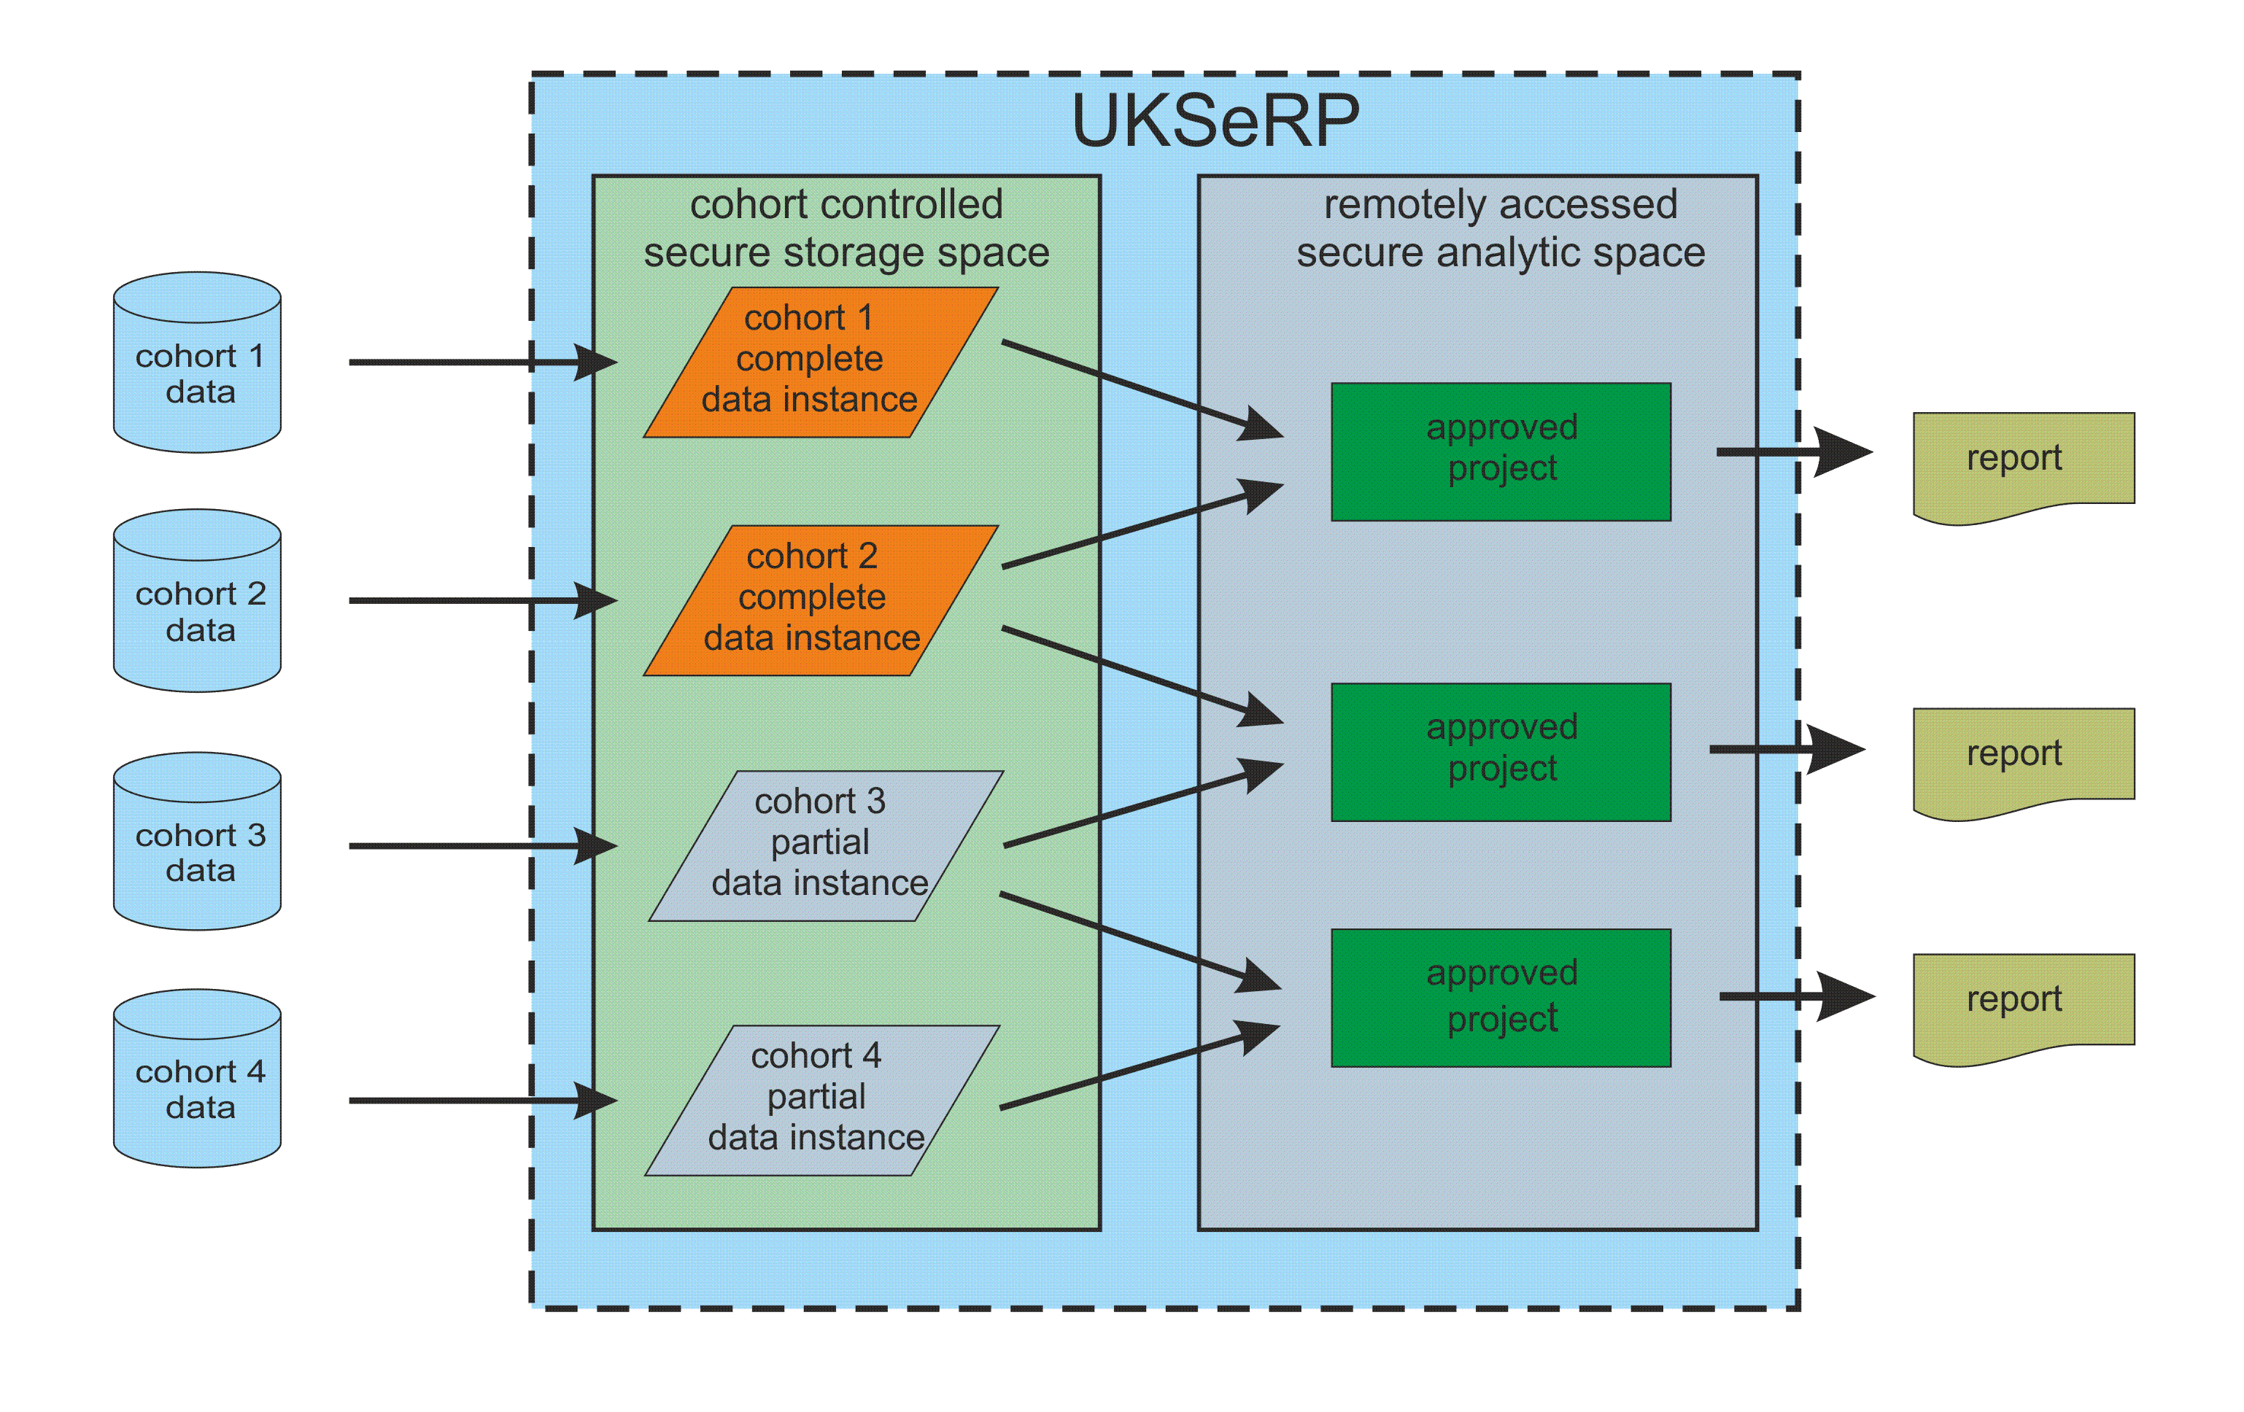
Rapid Data Access

Slide 8
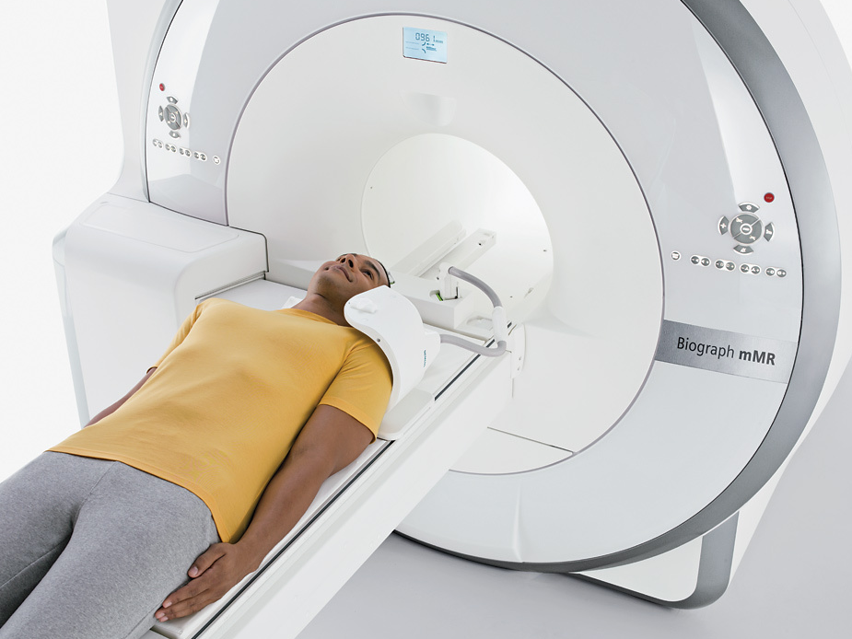
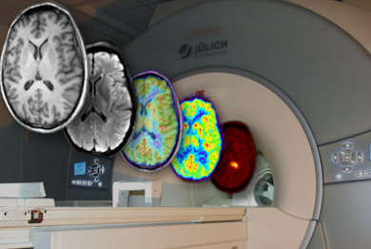
Technology networks: PET/MR (7 sites)
Step change in molecular imaging capability
Lowering barriers to, and increasing the impact of, imaging studies
Economies of scale
Knowledge sharing and standardisation of protocols
Recruitment of highly characterised cohort participants

Slide 9
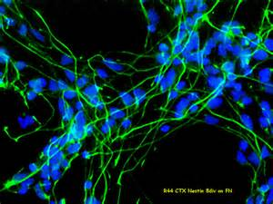
Technology networks: iPS Cells (6 centres)
Provide neuronal models of clinical phenotypes
Preserve cell lines from cohorts
Develop cellular basis of disease stratification
Interrogate pathogenic pathways
Early drug development studies

Slide 10
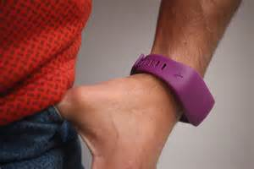
Technology networks: Informatics (5 centre)
>30 Cohorts (Swansea)
Imaging and EHR linkage (Oxford)
Wearable and other Devices (Manchester)
Genomics (Cardiff)
Tissue and Brain banking (Bristol)

Slide 11
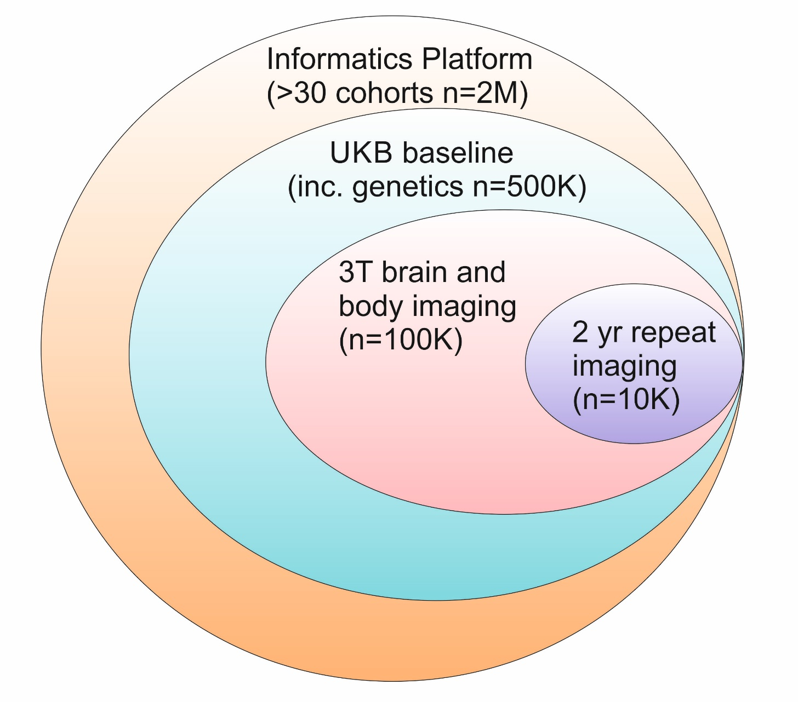
Highly characterised trials recruitment

Slide 12
Highly characterised trials recruitment
Deep and Frequent
Phenotyping study
EPAD adaptive trial

Slide 13
Risk stratification for clinical studies (and in silico experiments)
Sample | N
UKB base population | 502,713
Episodic memory | 498,053
Episodic memory >2 SD below mean | 17,096
…… plus age 55 years+ | 12,447
…… plus APOE4 carrier (20%) | 2,489

Slide 14
Progress
Data access
Informatics infrastructure complete
Legal agreements being finalised
Early adopter cohorts ready to upload data
Early grant success (IMI ROADS≈€4M)
Networks
procurement complete
Early grant success (MRC≈£2M)
Experimental medicine
Groups formed and programmes initiated
Early grant success (MRC≈ £6M)

Slide 15
Opportunities: collaboration
Data access
Register as a scientist through the website
Apply for data access through the portal
Portal goes live imminently
Cross-initiative partnerships
Canada: CCNA, CLSA
USA: ADNI, GAAIN
Europe: MEMENTO, DZNE, ROADS

Slide 16














WWW.dementiasplatform.uk

Slide 17
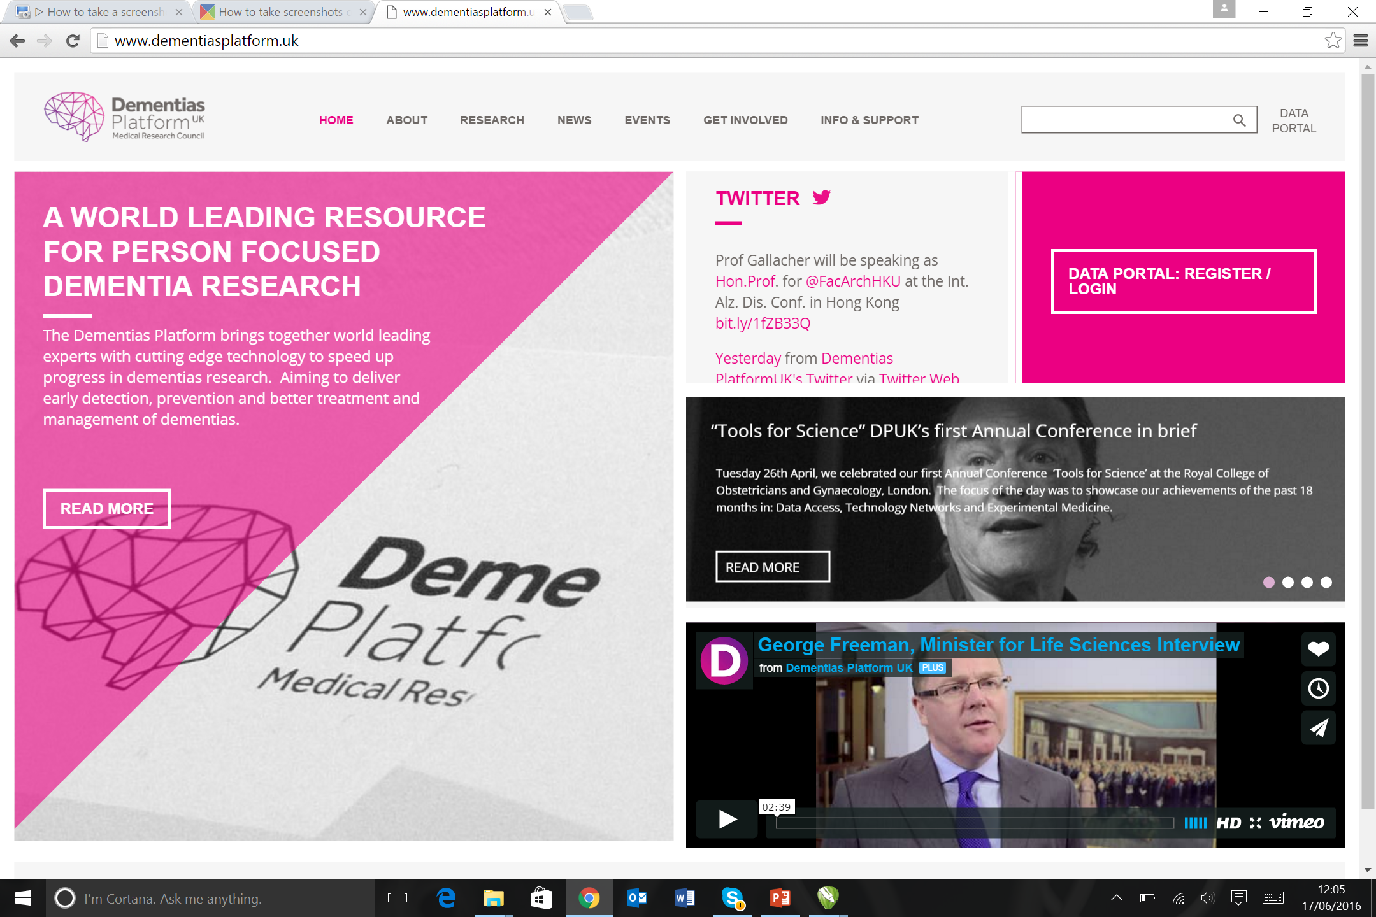
DPUK website: www.dementiasplatform.uk

Slide 18
Near continuous cognitive testing
Occasional clinical testing
-clinic based inconvenient
-interview based expensive
-screening ceiling effects
-global measure crude
-demotivating loss to follow-up
Epidemiologic
studies
Trials
TIME
App-based
Near-continuous population based testing
(regulatory approved)
-app based whenever
-fully automated inexpensive
-population assessment full distribution
-domain focussed pathology specific
-engaging incentivised return

Slide 19
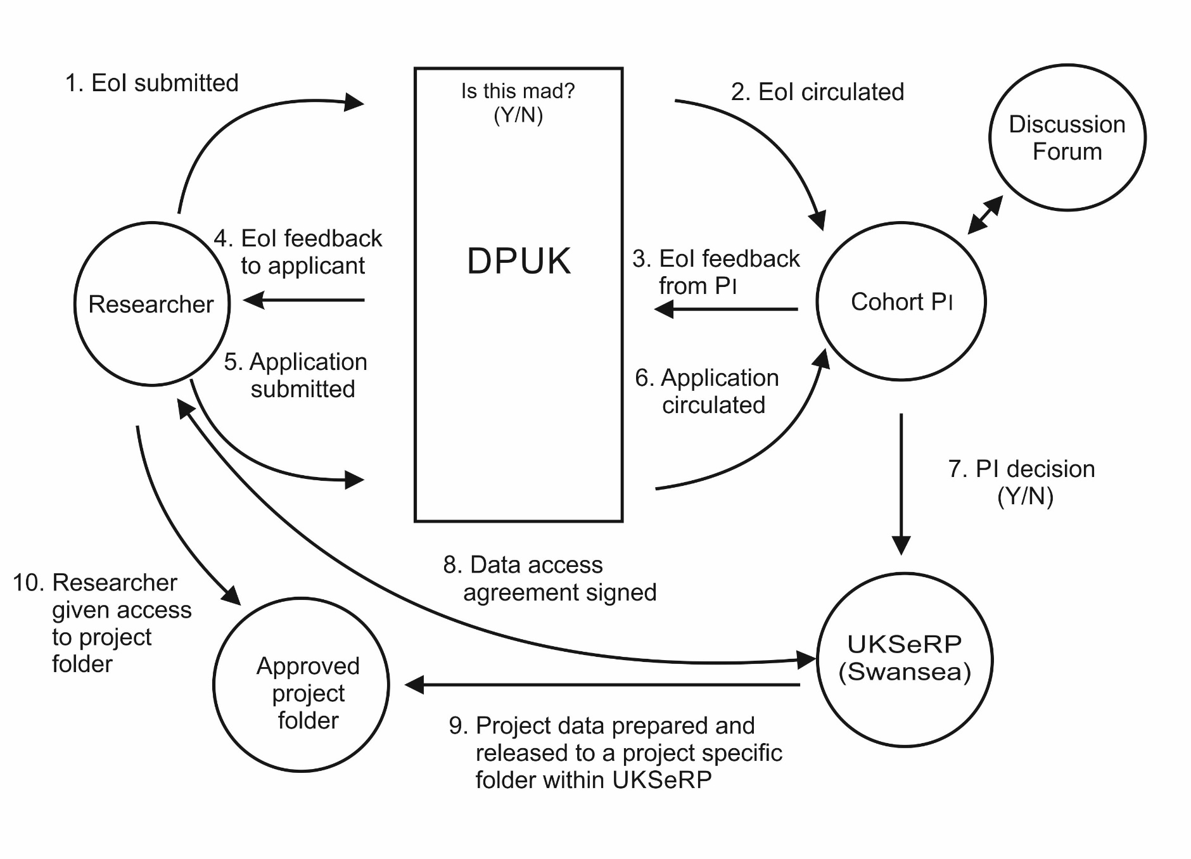
Rapid Data Access

Slide 20
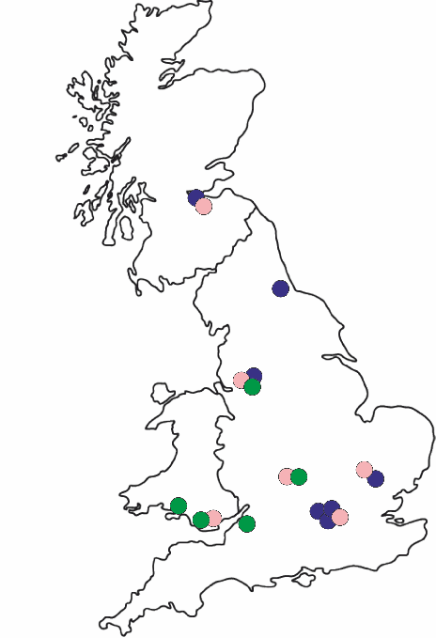
DPUK technology networks
7 centre imaging
6 centre stem cell
5 centre informatics
Linking cellular and molecular changes to patient selection and response
National coverage
Imaging
iPSC
Informatics

Slide 21
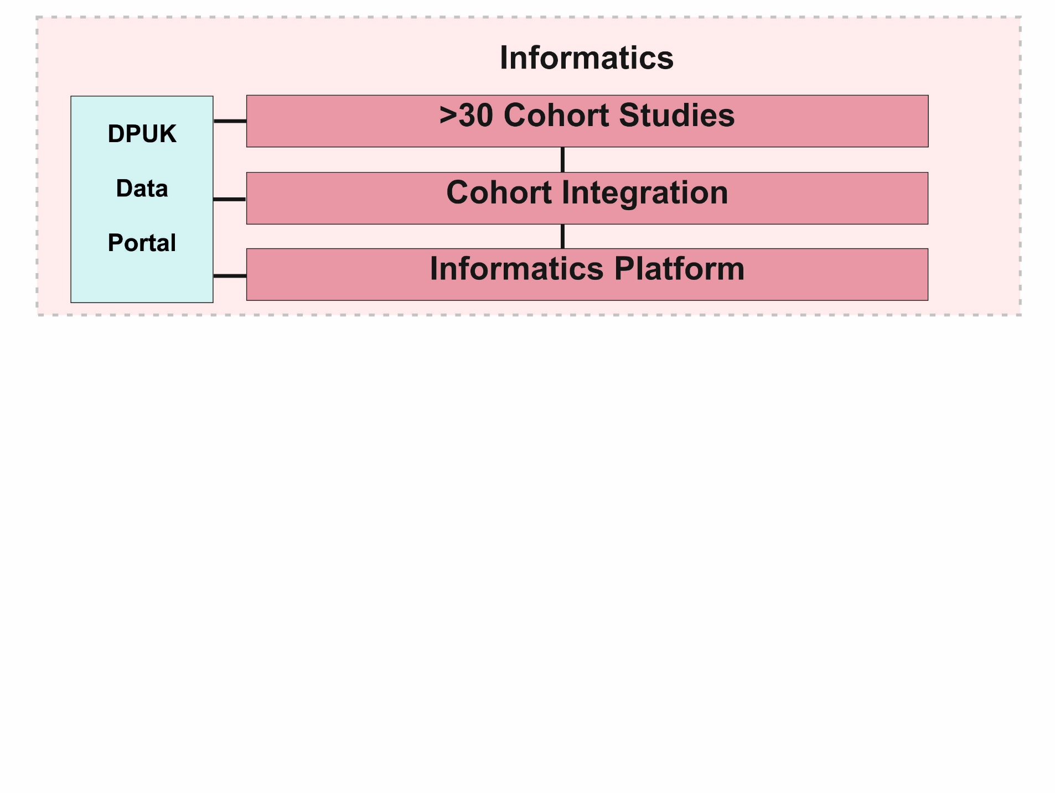
Integrated infrastructure

Slide 22
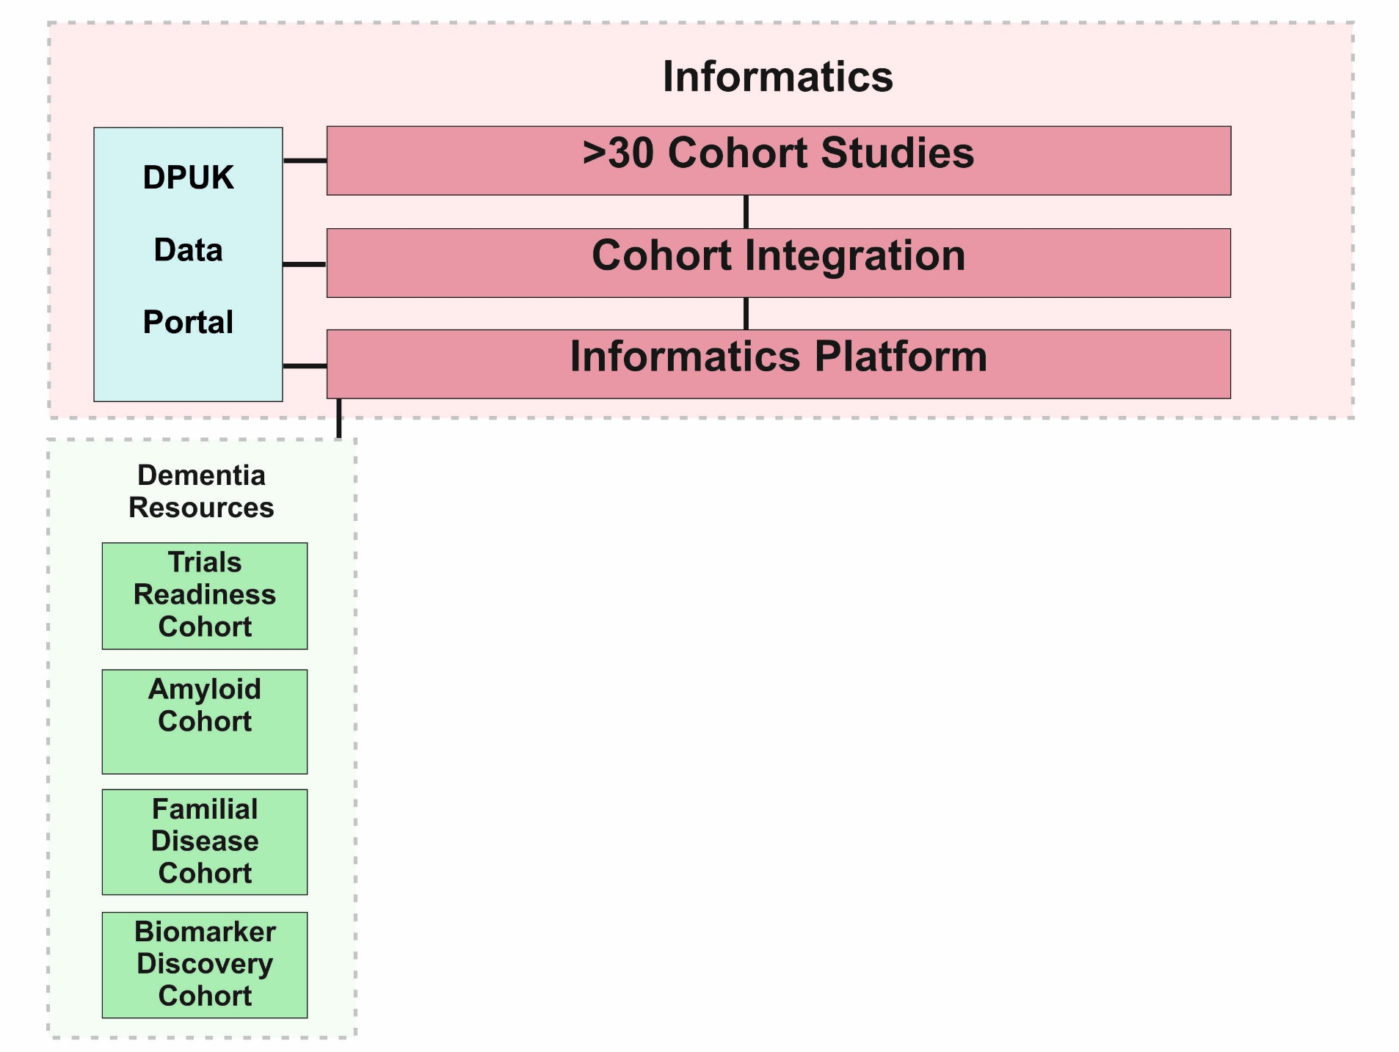
Integrated infrastructure

Slide 23
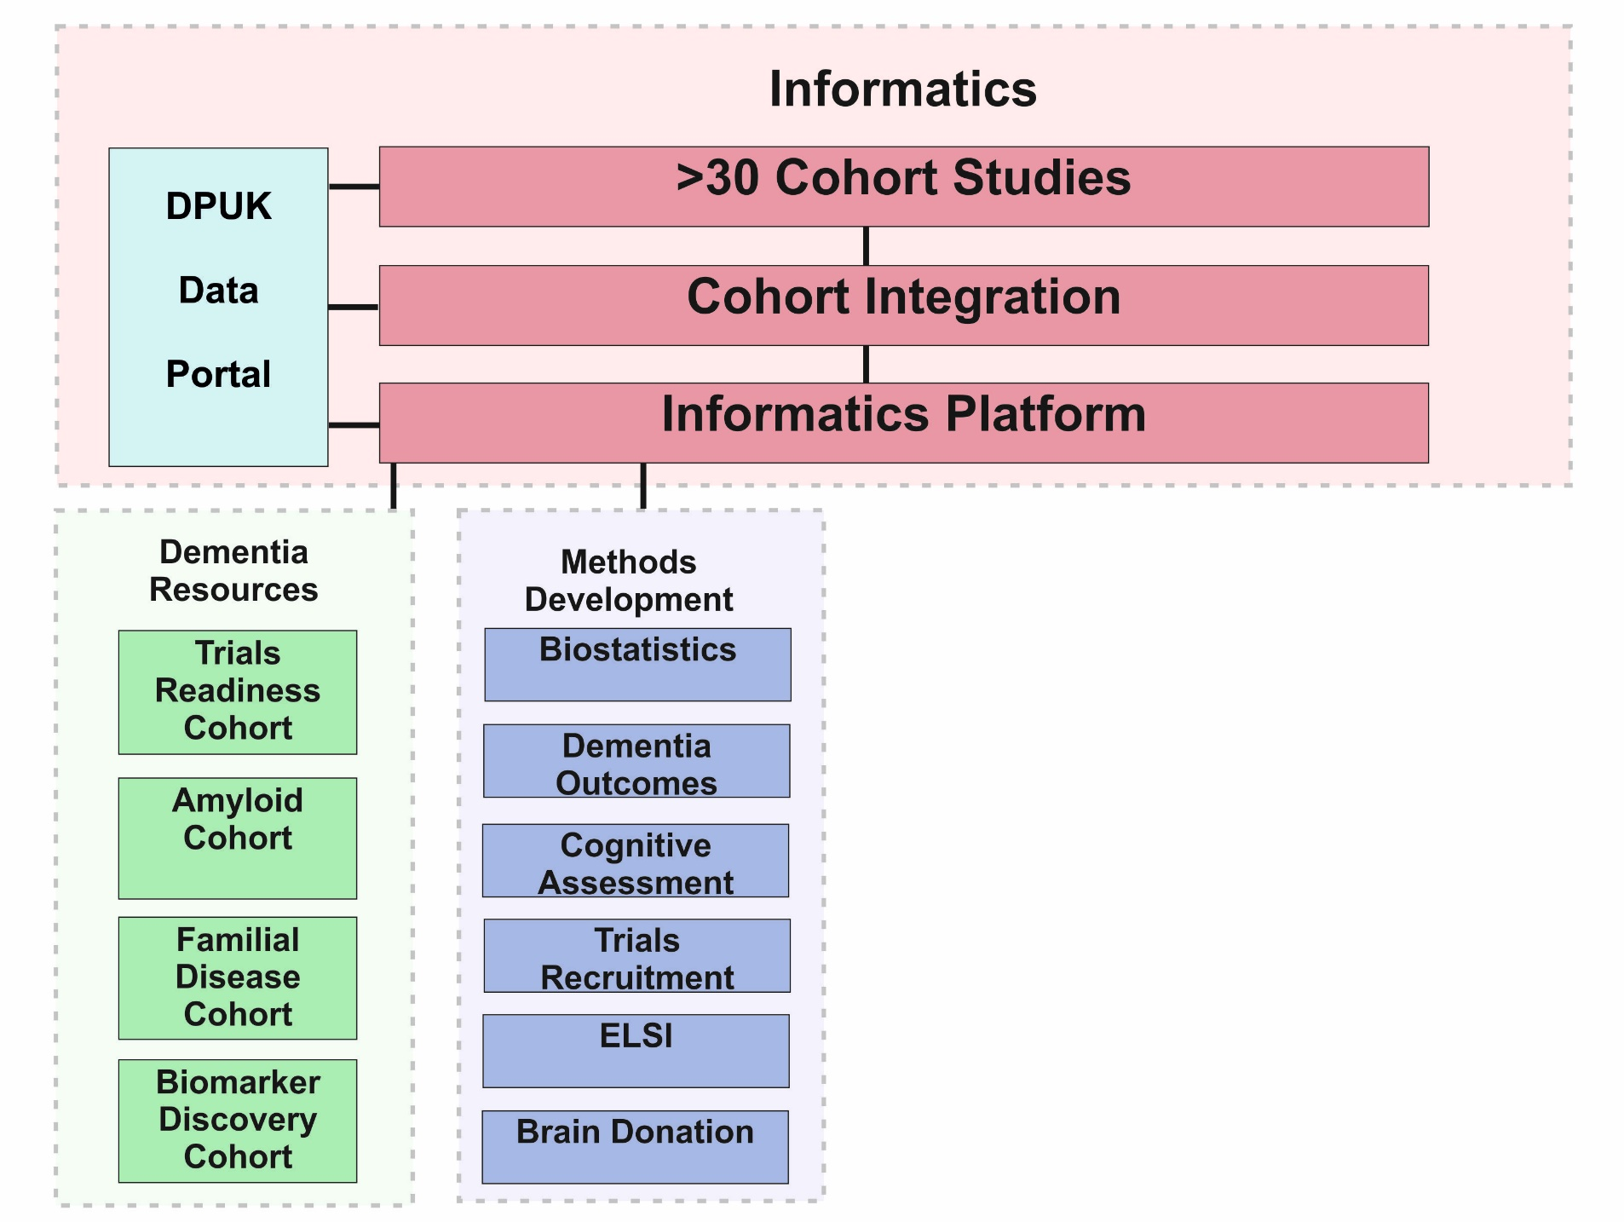
Integrated Infrastructure

Slide 24
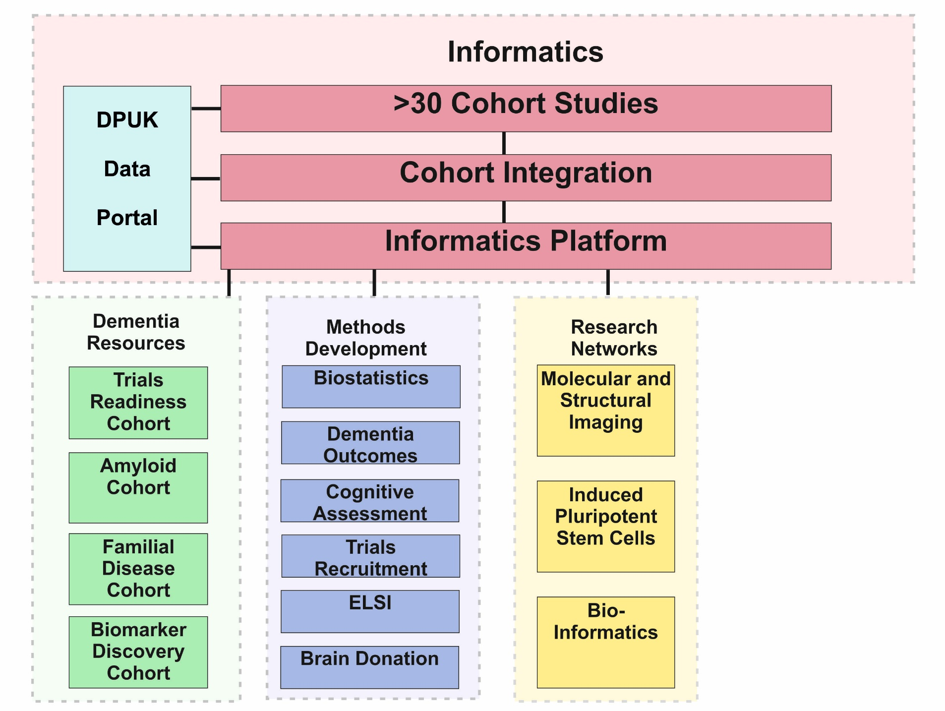
Integrated Infrastructure

